Slide 1
Applications of ICT (CS 108)
Sara Tariq Sheikh

Slide 2
Agenda
Problem Solving
  Basics
  Algorithms
  Pseudocodes
Mathematical Foundations for Computing
  Logic Building

Slide 3
Recap!
Key Points

Slide 4
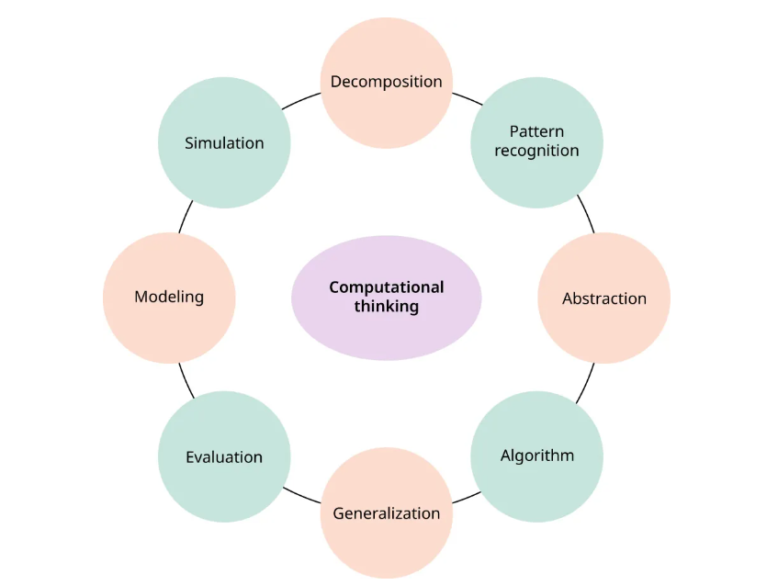
Computational Thinking

Slide 5
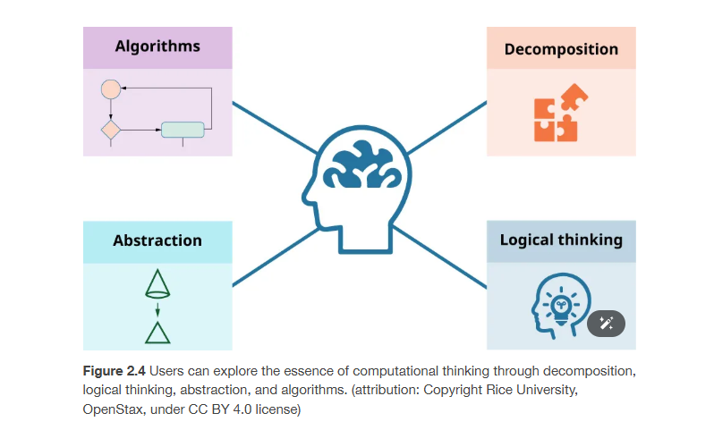
Computational Thinking

Slide 6
Example : Modern Games
Levels - Levels can be designed/created/tested/ independently of other levels
Characters - The mechanics of characters in the game can be designed and created by a separate team
Landscape - The art team can work on the visual aspects of the game without needing to understand how the game is programmed

Slide 7
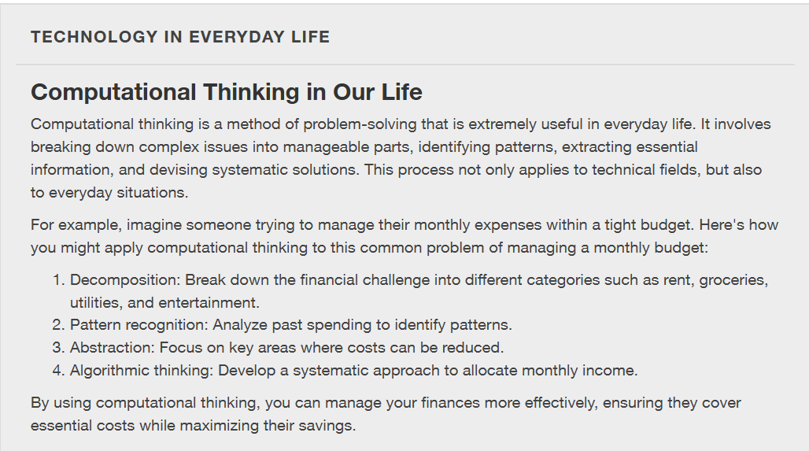
Example

Slide 8
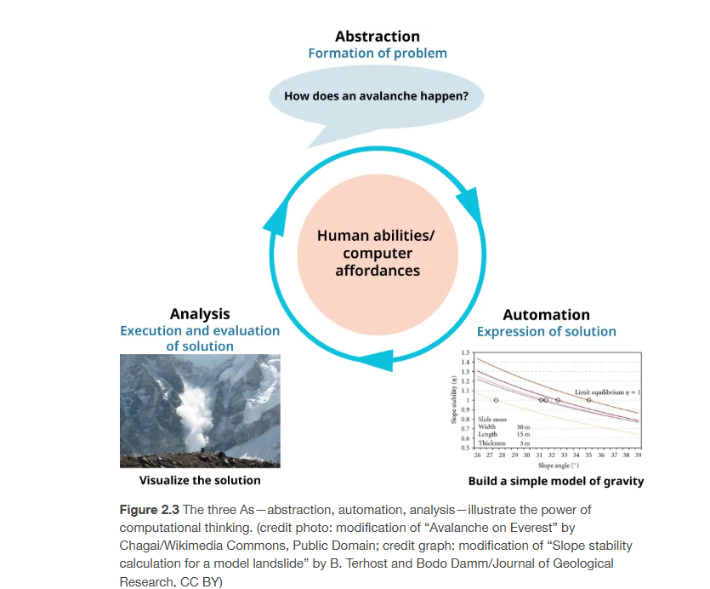
Abstraction – Automation - Analysis

Slide 9
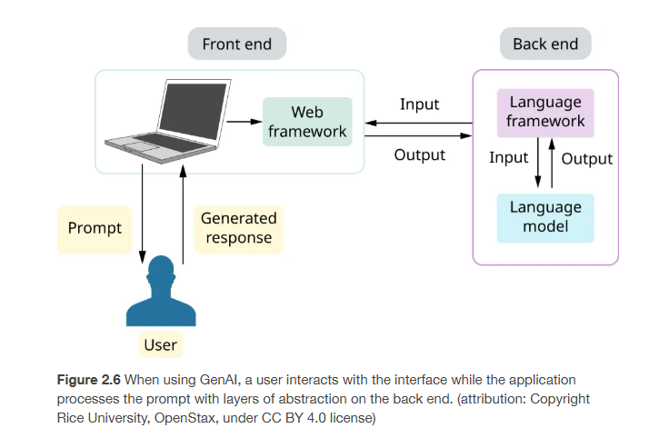
Abstraction

Slide 10
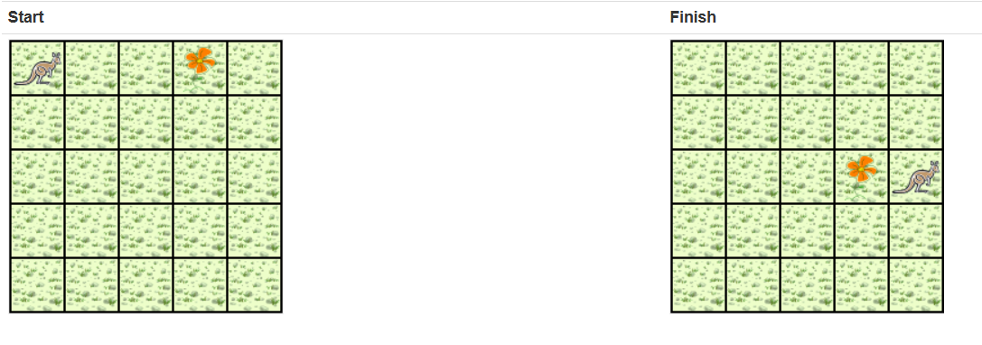
Example : Pick and Plant
A kangaroo starts at (0, 0) facing East with no flowers in its pouch. There is a flower at location (3, 0). Write a program that directs the kangaroo to pick the flower and plant it at location (3, 2). After planting the flower, the kangaroo should hop one space East and stop. There are no other nets, flowers, or kangaroo on the island.

Slide 11
Analysis
The flower is exactly three spaces ahead of the kangaroo. The flower is to be planted exactly two spaces South of its current location. The kangaroo is to finish facing East one space East of the planted flower. There are no nets to worry about.

Slide 12
High Level Algorithm Vs Detailed Algorithm
Get the flower
Put the flower
Hop East
Get the flower
  Hop 3 times
  Pick the flower
Put the flower
  Turn right Hop 2 times Plant a flower
Hop East
  Turn left Hop once

Slide 13
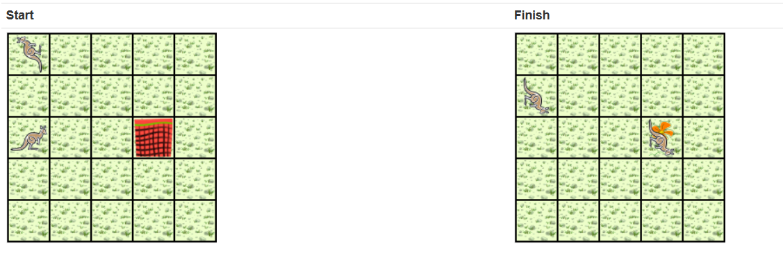
Question : Pick and Plant (Net)
There are two kangaroos. One kangaroo starts at (0, 0) facing North with one flower in its pouch. The second starts at (0, 2) facing East with one flower in its pouch. There is a net at location (3, 2). Write a program that directs the first kangaroo to give its flower to the second one. After receiving the flower, the second kangaroo must disable the net, and plant a flower in its place. After planting the flower, the kangaroo must turn and face South. There are no other nets, flowers, or kangaroos on the island.

Slide 14
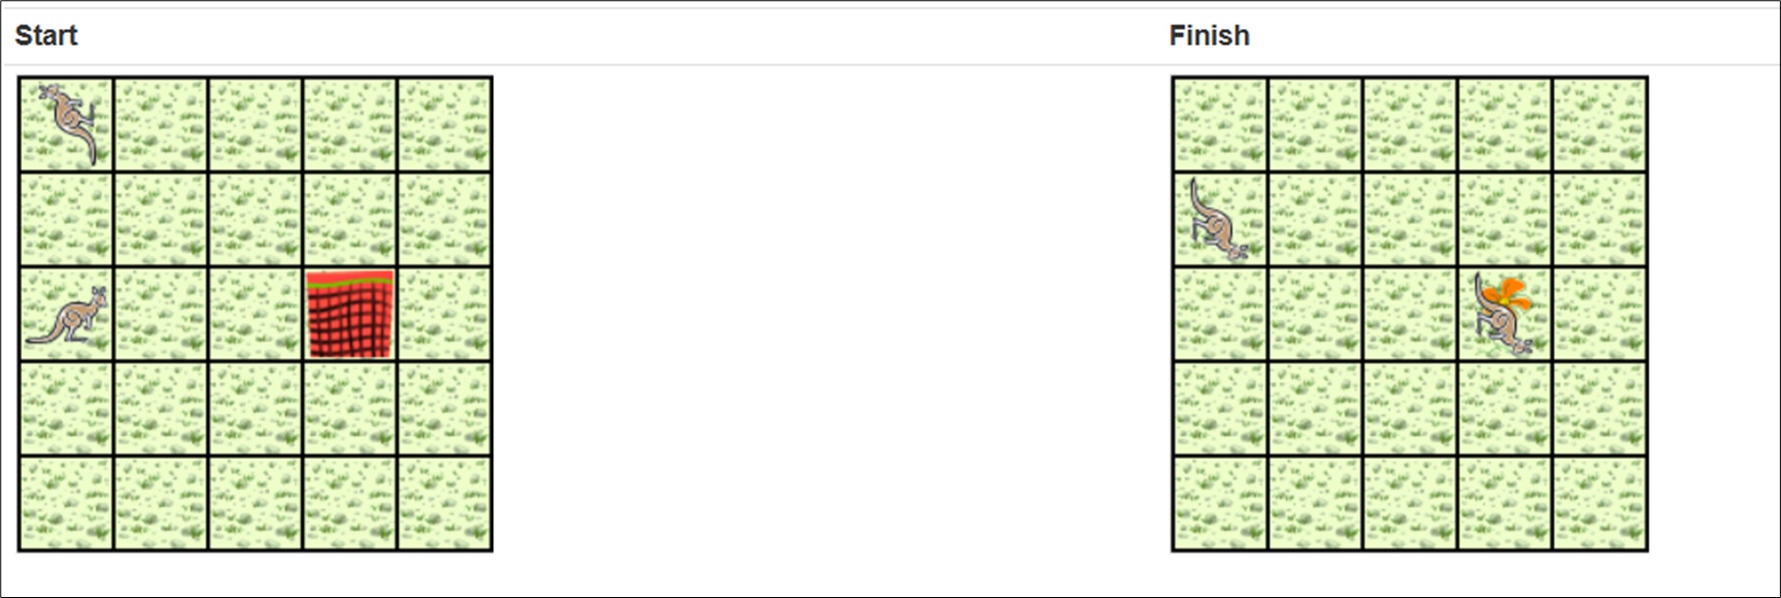
Analysis
kangaroo_2 is exactly two spaces behind kangaroo_1. The only net is exactly three spaces ahead of kangaroo_2. Each kangaroo has exactly one flower. kangaroo_2 will have two flowers after receiving one from kangaroo_1. One flower must be used to disable the net. The other flower must be planted at the location of the net, i.e. (3, 2). kangaroo_1 will finish at (0, 1) facing South. kangaroo_2 is to finish at (3, 2) facing South. Each kangaroo will finish with 0 flowers in its pouch. One flower was used to disable the net, and the other was planted.

Slide 15
High Level Algorithm Vs Detailed Algorithm
kangaroo_1 should do the following:
  Find kangaroo_2 (but don't collide with him)
  Give a flower to kangaroo_2 (he will be straight ahead)
After receiving the flower, kangaroo_2 should do the following:
  Find the net (but don't hop onto it)
  Disable the net
  Plant a flower at the location of the net
  Face South
kangaroo_1 should do the following:
  Find kangaroo_2
    Turn around (either left or right twice)
    Hop (to location (0, 1))
  Give a flower to kangaroo_2 Give ahead
Now kangaroo_2 should do the following:
  Find the net
    Hop twice (to location (2, 2))
  Disable the net
    Toss
  Plant a flower at the location of the net
    Hop (to location (3, 2))
    Plant a flower
  Face South
    Turn right

Slide 16
Logic

Slide 17
Making your Argument Trustworthy
State the claim clearly (what exactly you’re proving).
List assumptions/preconditions (what must be true first).
Use valid steps only (no leaps; justify each move).
General ≠ example: testing some cases ≠ proof for all cases.
Avoid circularity: don’t use the result to prove itself.
Name the structure (direct, contradiction, contrapositive, induction).

Slide 18
Relationship to Problem Solving
Argument Principle | Algorithm Equivalent
Clear claim | Define goal/output
Preconditions | Input constraints
Valid steps | Correct logic
General ≠ Example | Avoid testing only one case
No circularity | No assumptions based on result
Structure | Algorithm type (recursive, brute-force, etc.)

Slide 19
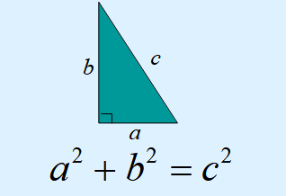
Familiar? Obvious?

Slide 20
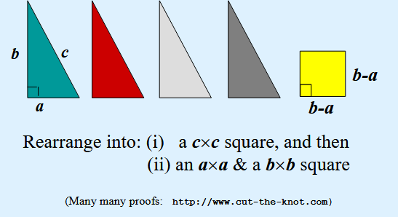
A Cool Proof

Slide 21
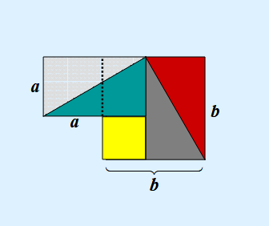
A Cool Proof

Slide 22
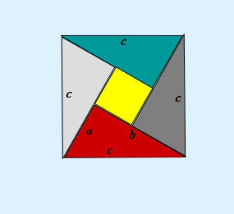
A Cool Proof

Slide 23
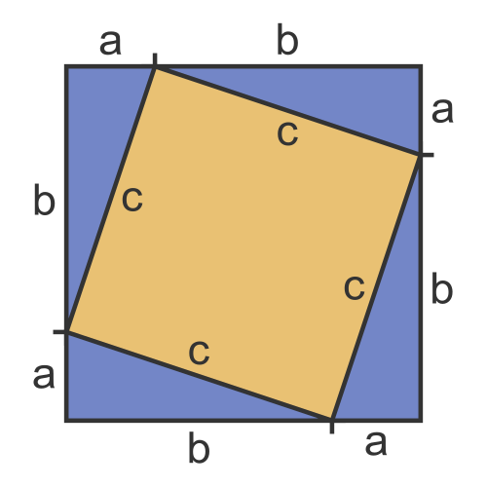
A Cool Proof

Slide 24
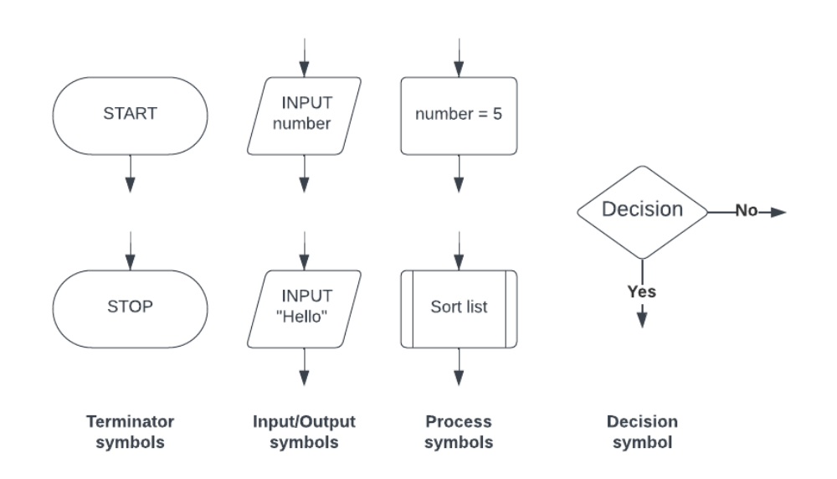
Flowcharts

Slide 25
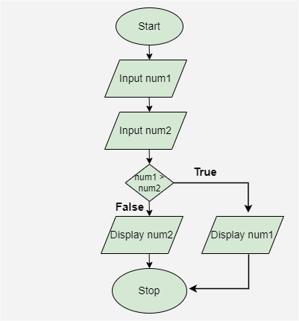
Draw a flowchart to input two numbers from the user and display the largest of two numbers.

Slide 26
Can you explain what this algorithm does?
Count ← 1
Number ← 0
Total ← 0
REPEAT
INPUT Number
Total ← Total + Number
Count ← Count + 1
UNTIL Count > 10
OUTPUT Total
The purpose of the algorithm is to add ten user-entered numbers together and output the total
The processes are:
  initializing three variables (Count, Number, Total)
  inputting a user number
  adding to two variables (Total, Count)
  repeating nine more times
  outputting the final Total value

Slide 27
Describe what’s happening here?
Count ← 0
REPEAT
INPUT Score[Count]
IF Score[Count] >= 70 THEN
Grade[Count] ← "A"
ELSE
IF Score[Count] >= 60 THEN
Grade[Count] ← "B"
ELSE
IF Score[Count] >= 50 THEN
Grade[Count] ← "C"
ELSE
F Score[Count] >= 40 THEN
Grade[Count] ← "D"
ELSE
IF Score[Count] >= 30 THEN
Grade[Count] ← "E"
ELSE
Grade[Count] ← "F"
ENDIF
ENDIF
ENDIF
ENDIF
ENDIF
Count ← Count + 1
UNTIL Count = 30
Notes:
Inputted marks are stored in the array Score[]
Marks are then checked against a range of boundaries
A matching grade is assigned to each mark that has been input
The grade is then stored in the array Grade[]
At the same index as the inputted mark
The algorithm finishes after 30 marks have been input

Slide 28
Problem Solving & Computational Thinking: Summary
Write it down(in your own words); Investigate
Split it in sub-problems
Identify the problems that are familiar & similar
Remove ambiguity
Identify the starting and ending states; means-end analysis
Split the problem; divide & conquer
Build solution; Building blocks or Merge Solutions

Slide 29
Example
“compute the average of a list of values”
  Calculate the sum of values + Count the values + Calculate Average
  If we already have separate solutions for summing values and for counting the number of values, we can combine them.
  if we first do the summing and then do the counting, we have to read the list twice.
  We can save steps if we merge these two solutions: read a value and then add it to the running total and add 1 to our count before going on to the next value.
  Calculate Average
“Whenever the solutions to sub-problems duplicate steps, think about merging them instead of joining them end to end.” (mcmillan)

Slide 30
Examples
Organizing a city’s recycling program to maximize efficiency. How can you ensure the most effective collection routes and times?
  Solution: Use a route optimization algorithm to analyze and plan the most efficient paths for collection trucks, considering factors like distance and traffic patterns.
Planning the layout of a community garden to optimize space and sunlight exposure for different plant types. How do you decide where to plant each type of vegetable or flower?
  Solution: Employ a simulation algorithm that models sunlight patterns, plant growth rates, and space requirements to design a garden layout that maximizes space and plant health.

Slide 31
Try it on C++
Confirm (by experiments) that for a, b ≥ 0,
AM = (a+b)/2 ≥ GM = √(ab), and reject invalid inputs.
AM = Arithmetic Mean
GM = Geometric Mean

Slide 32
Working out the Steps….
Read how many test pairs n.
Loop n times: input a and b.
If a<0 || b<0, then print “requires a,b ≥ 0” and skip.
Compute AM=(a+b)/2, GM=sqrt(a*b).
Print AM, GM, and whether AM >= GM.

Slide 33
Algorithm
Start
Prompt user to enter values of a and b
Check if inputs are valid:
If a < 0 or b < 0,
  → Display error: "Invalid input: a and b must be ≥ 0“
  → End Program
Compute Arithmetic Mean (AM):
  AM = (a + b) / 2
Compute Geometric Mean (GM):
  GM = sqrt(a * b)
Compare AM and GM:
  If AM ≥ GM,
  → Display: "AM ≥ GM confirmed“
Else,
  → Display: "Unexpected AM < GM — Check calculations“
End

Slide 34
Link to Program
https://www.programiz.com/online-compiler/7moV3gs9PzNZT

